Slide 1
Artist and Research

Slide 2

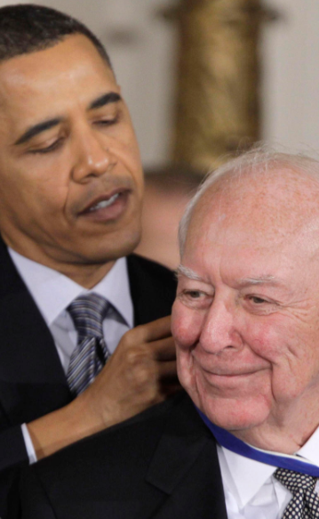
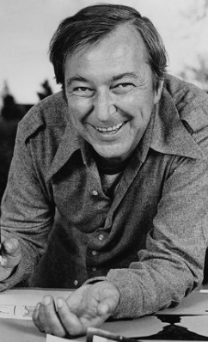
Jasper Johns
Paintings
Prints
Sculptures

Slide 3
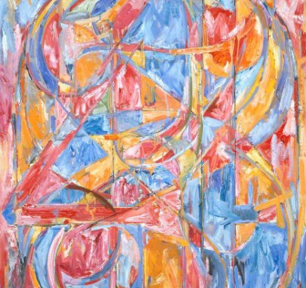
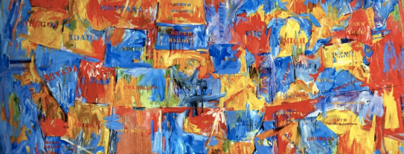
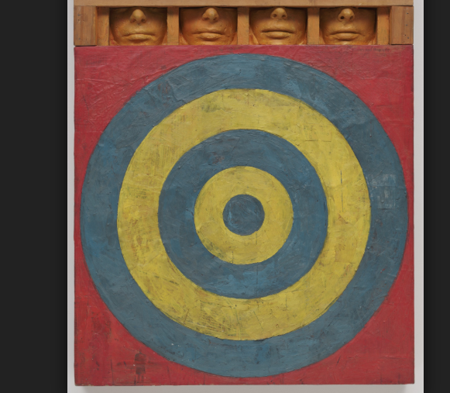
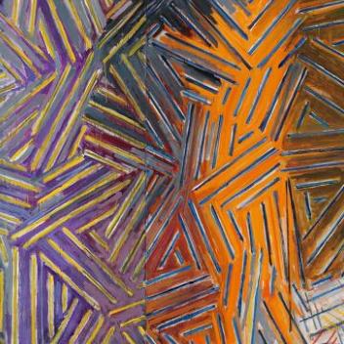
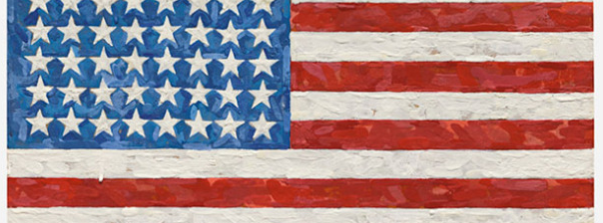

Slide 4
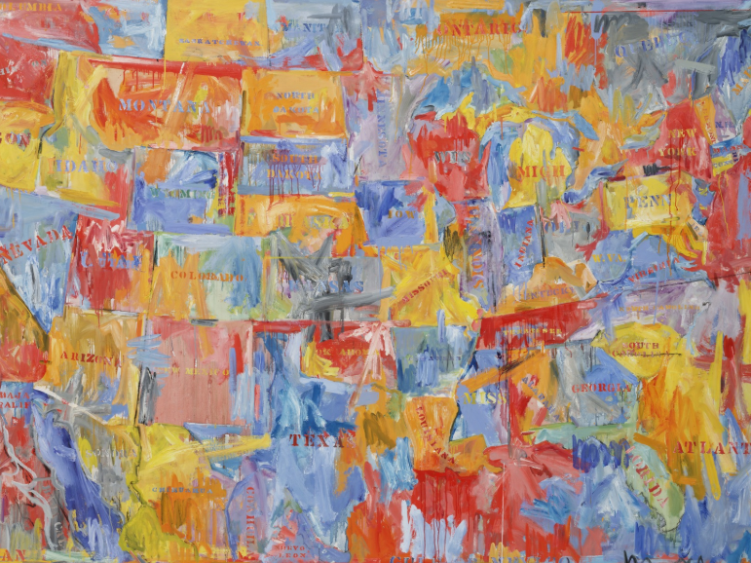
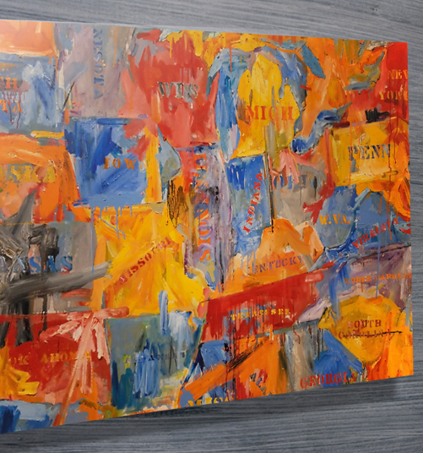

Slide 5
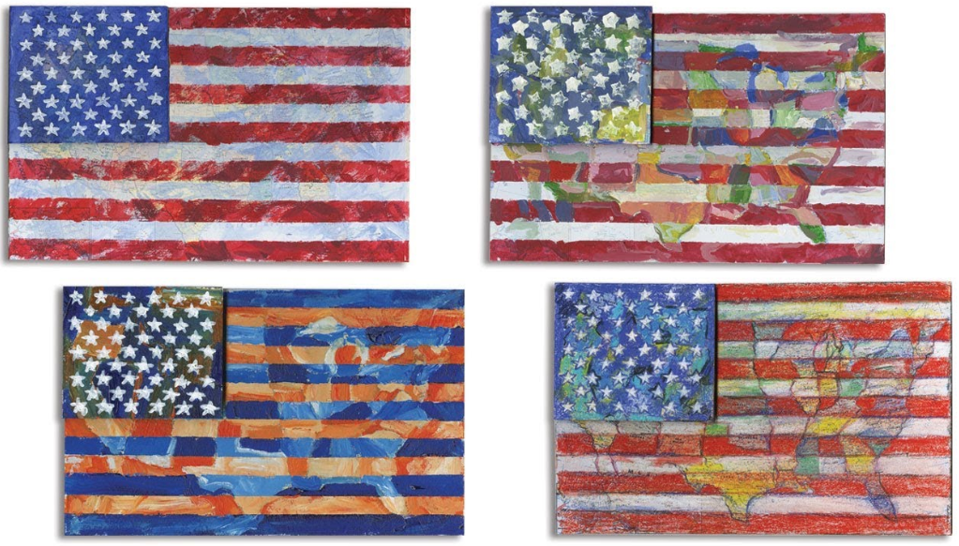

Slide 6

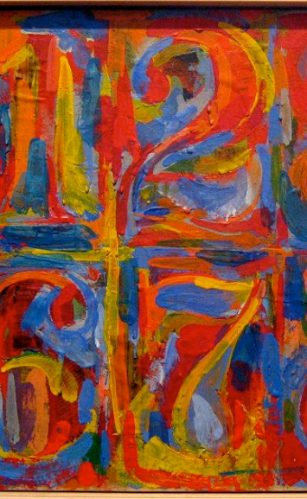
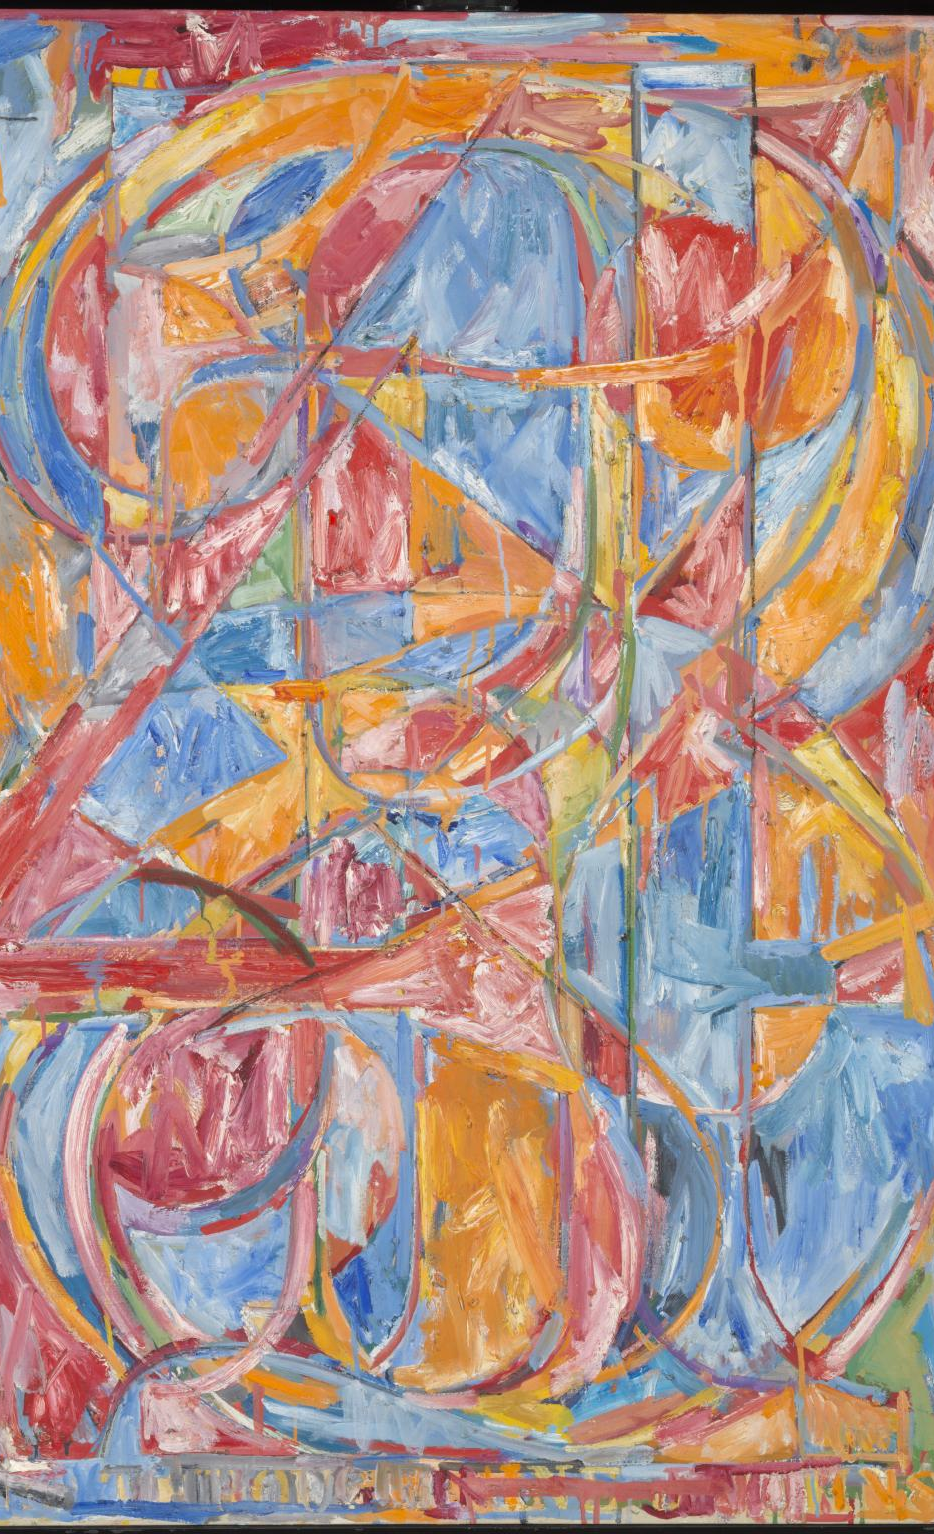

Slide 7
Branding Design

Slide 8

Maps
Stamps with text input
White Textures
Dripping Textures

Slide 9


Flags
Layers
Picture Overlay
Opacity

Slide 10

Numbers
Rainbow colour stroke
White Textures
Fill bucket with op art textures

Slide 11
Layout and interaction planning

Slide 12
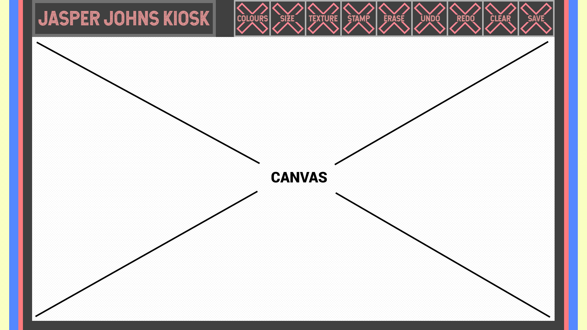

Slide 13
Technical

Slide 15
References
https://news.artnet.com/art-world/jasper-johns-wanted-young-people-to-see-his-art-the-broads-retrospective-has-pulled-it-off-1228133
http://www.jasper-johns.org/
https://www.biography.com/people/jasper-johns-9355664
https://artuk.org/discover/artists/johns-jasper-b-1930
https://www.thetimes.co.uk/article/visual-art-review-jasper-johns-something-resembling-truth-at-the-royal-academy-w1-zghg86g3h
http://www.artnews.com/2014/11/11/36-m-flag-sets-jasper-johns-record-at-sothebys-343-7-m-contemporary-art-auction/
https://www.moma.org/collection/works/78393
https://thewestologist.wordpress.com/tag/jasper-johns/
https://www.canvasprintsaustralia.net.au/product/jasper-johns-map/
https://www.tes.com/lessons/tWW1VQ4pcom_Ag/abstract-number-art-j-johns

